Slide 1
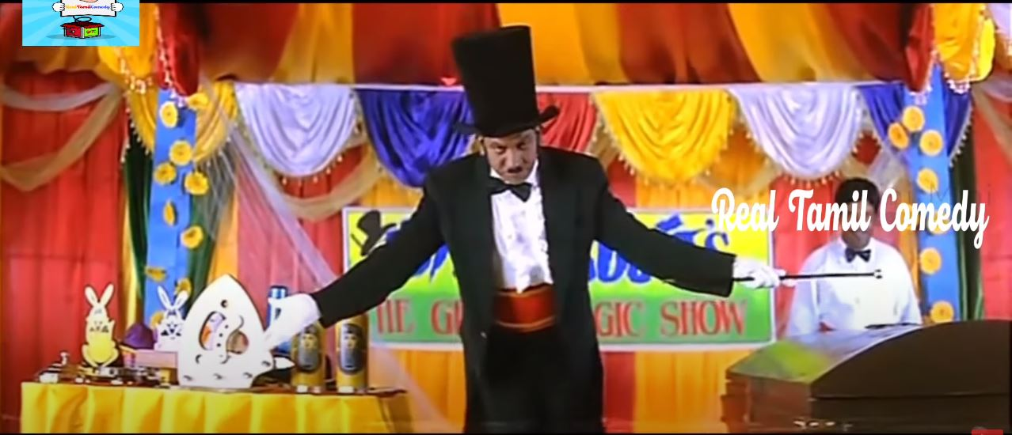

Slide 2
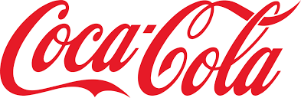
Change management - A case STUDY of Coca Cola
There is nothing permanent than change!​
- Heraclitus, Greek Philosopher​
By
Anju
Mani
Nikitha
Saravanan

Slide 3
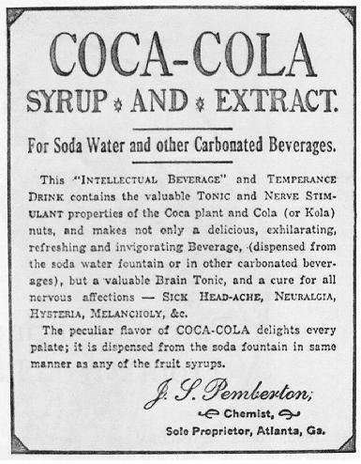
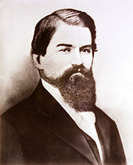
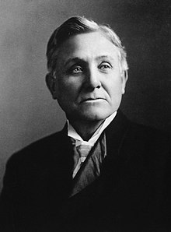
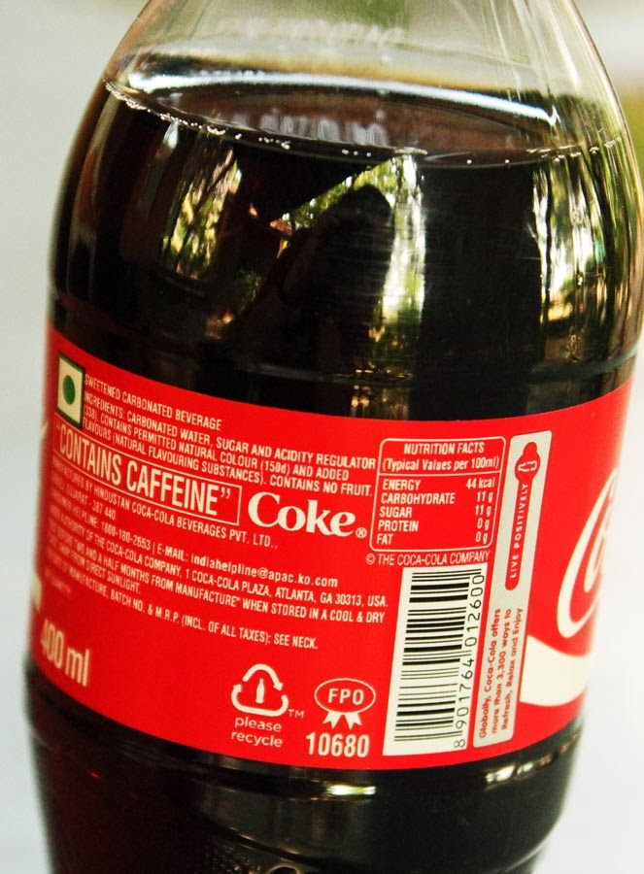
Organisation at a glance:
The Coca-Cola Company is the largest non-alcoholic beverage company in the world. It serves 1.9 billion or 3.2% of the total 60 billion beverage servings of all types consumed worldwide every day. The company owns, distributes and sells over 500 various non-alcoholic beverage brands in over 200 countries.
Coca Cola is a type of company that requires constant changes in its products and business strategies according to the consumer expectations and external environment.
As per the case study the organization has undergone several changes in their products and strategies.
Major changes incorporated as per the case study were acquisition of business during Asian financial crisis.
Changes made in the product basket like introducing diet coke, Coca cola Zero etc., for health conscious consumers.
John Stith Pemberton
Asa Griggs Candler

Slide 4
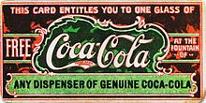
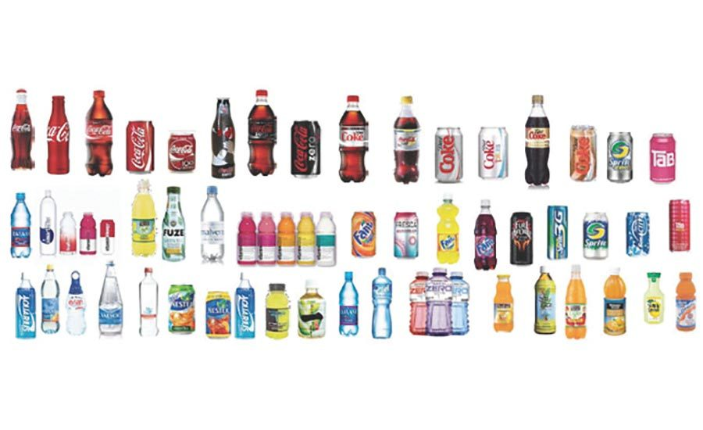
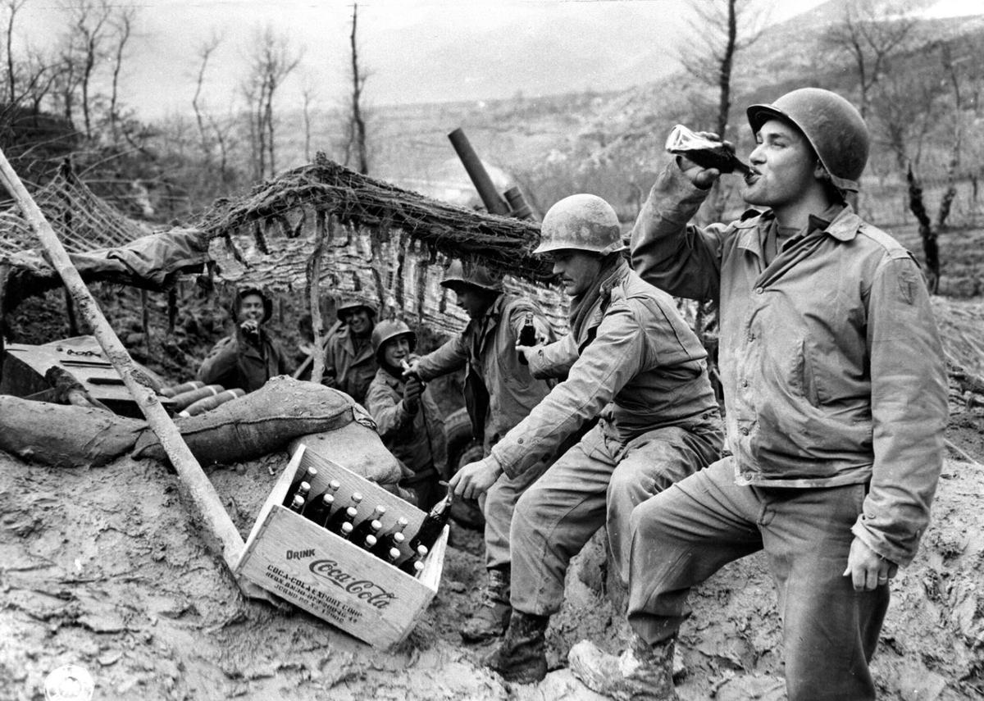
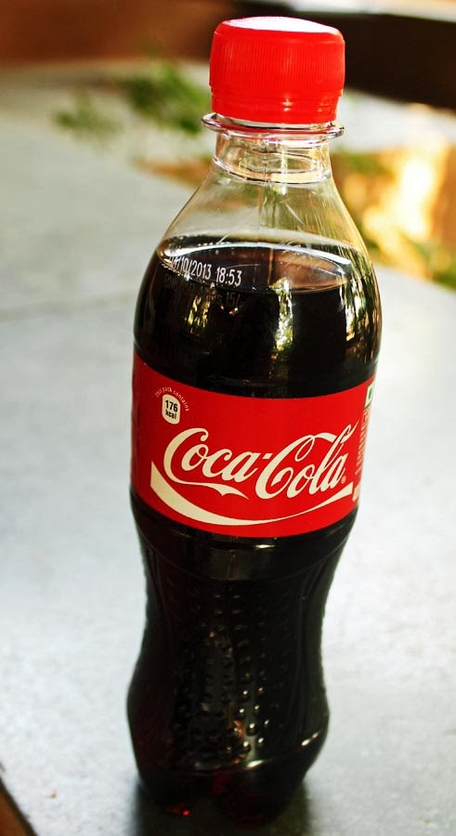
What went well?
The company provided free drinks for soldiers during WW II which helped the organisation achieve two objectives (patriotism and expansion of business). Around 5 billion bottles of coke was consumed by US forces. During the same time Fanta was also introduced.
The entry of the United States into the war brought an order from Robert Woodruff in 1941 "to see that every man in uniform gets a bottle of Coca-Cola for 5 cents, wherever he is and whatever it costs the Company.“
Acquisition strategy in time of Asian financial crisis which helped them to increase their product coverage (coffee, tea and bottling)
The company was able to proactively diversify its business by addressing the needs of health conscious consumers.

Slide 5
What went well (Contd…)
Change Management:
External: Govt Laws, Labor market, market condition etc.,
Internal: Work force, resource available, attitude of workers
Company adopted Kotler theory of organization change
Employee Engagement : It's an integrated approach on developing intrinsic values and employee motivation. As employees believe in values, coca cola wants to become the inherent part of employee at personal level. “building capability in engagement, maintaining engagement momentum and ensuring that engagement is integrated into CCR’s people practices” (Samdahl,2011)
Stakeholder Management: By doing Force Field Analysis, Coca Cola Company will be able to induct people who are in need of appropriate training. Another useful tool is AKADAR model which stands for Awareness, Desire, Knowledge, Ability and Reinforcement.

Slide 6
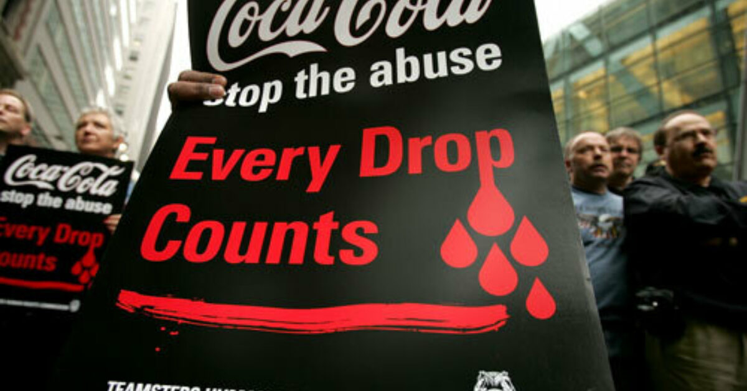
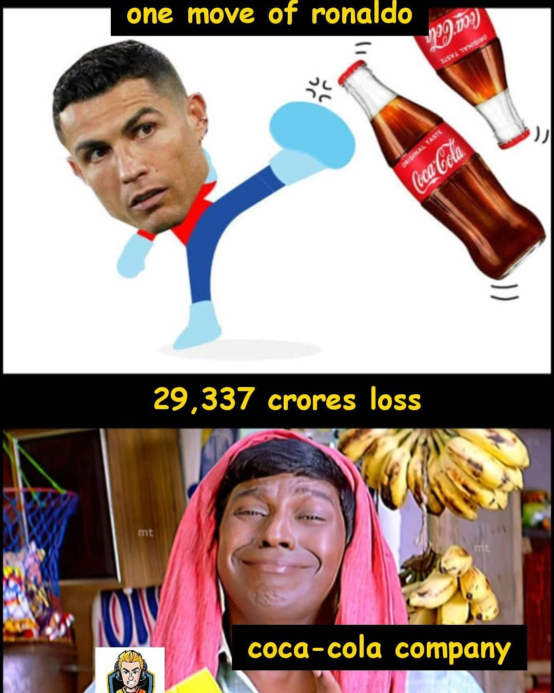
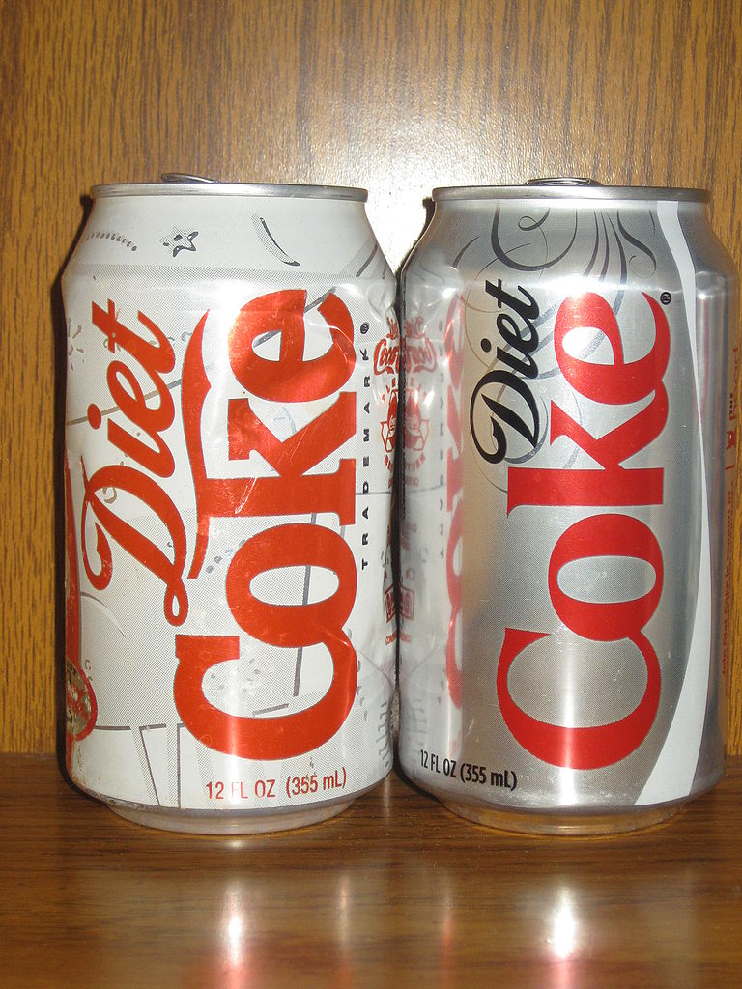
What did not go well ?
In the year 1985 Coca Cola’s rival Pepsi co introduced a new drink which had smooth taste and more sweetness. In response to this, Coca Cola had introduced their range in the name of “new coke”.
The above event was famously addressed as the ‘Cola wars’ in 70s and 80s.
Coca Cola failed in their new drink and sales gradually went down and company faced severe consumer critics and protest. Subsequently “new coke” was discontinued in 2002.
The above incident had to led to nation wide protests in the US.
Apart from the above there are more instances of failure of products after their launch.

Slide 7

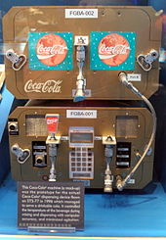
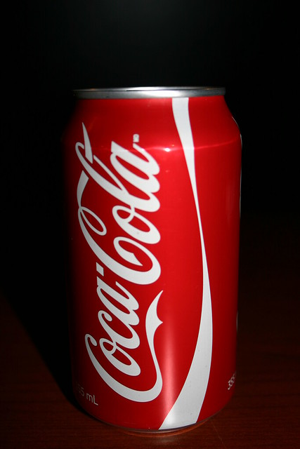
Conclusions/Learning Outcomes
Open system where communication is seen as an integrated process that facilitates change within the organization.
New system that can be adopted by the company may be the “machine bureaucracy” which Henry Mintzberg (1992) defined as an organization with clearly defined hierarchy, well defined area of operations, standard operating procedures.
Various concepts of change management and employee engagement was adopted by Coca Cola for successful transition for every change made.
Strong branding is important for sustenance of the business. Coca-Cola sponsored the 1928 Summer Olympics in Amsterdam (India's 1st gold medal in olympics), where people from all over the world became familiar with the Coca-Cola logo, which appeared on everything from hats and bulletins to the walls of the city streets
Embracing changes is the key for constant evolving in the business.

Slide 8

EMBRACE THE CHANGE BUT CHOOSE WISELY !!

Slide 9
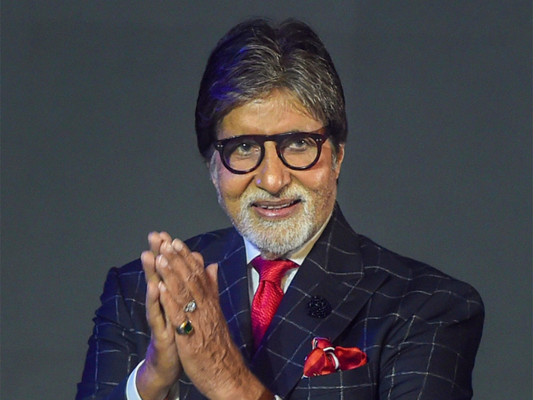
Thank YOU !!

